Slide 1

Sauce & Spoon
Tablet Rollout
Impact Report

Slide 2
Executive Summary
Sauce & Spoon wants to launch a pilot rollout of tabletop menu tablets at two of our restaurant locations, Sauce & Spoon North and Sauce & Spoon Downtown. The project includes researching and selecting a tablet and vendors, adding a revamped menu and special features to the tablets, training staff, and installing them at the bars of 2 locations. The system will be rolled out at the beginning of quarter 2 in April, and monitored through the end of June to gauge success. Methodology: We used a waterfall approach for the entire project, with aspects of the Agile mentality applied, like preparing for changes and staying flexible with our schedule and budget.

Slide 3
Accomplishment Summary
We reduced the average table wait time to under 10 minutes.
We eventually reduced table turn time by 30 minutes.
The average tablet checkout time has stayed at one minute or less.
Achieved less than 5% of customer’s reporting technical issues each week.
Increased daily guest count by over 20% at the Downtown location.
We just succeeded in reducing food waste by 25%.

Slide 4
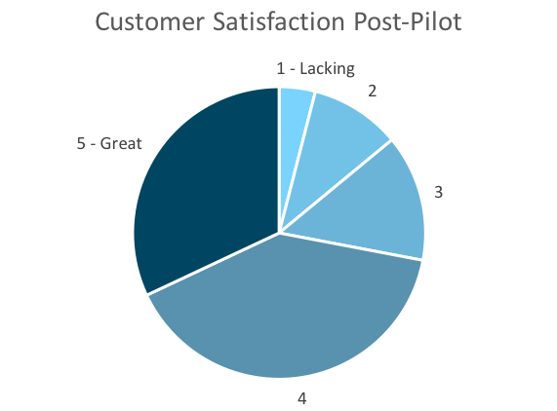
Customer Satisfaction: Pilot
Q. On a scale of 1-5, please rate your experience with the tablet overall.
This pie chart illustrates the results from the post-pilot survey.
72% of respondents indicated a customer satisfaction score of 4 or 5.
Notes:
First pie chart: Results from the post-pilot survey
Second pie chart: Results from the post-launch survey, after making changes
Satisfaction has gone up from 72% (4 and 5 rating) to 86% (4 and 5 rating)
Post-pilot data:
1 - Lacking 2 4%
2 5 10%
3 7 14%
4 20 40%
5 - Great 16 32%
Post-launch data:
1 - Lacking 1 2%
2 2 4%
3 4 8%
4 22 44%
5 - Great 21 42%

Slide 5
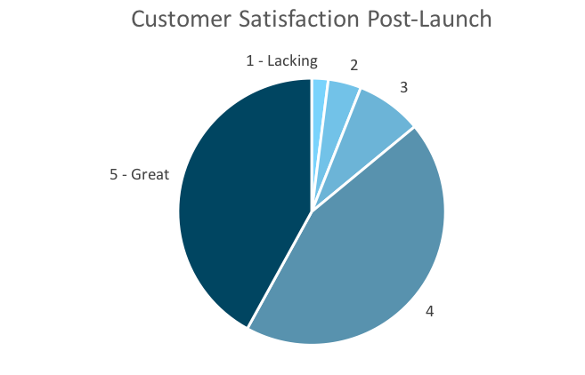
Customer Satisfaction: Launch
Q. On a scale of 1-5, please rate your experience with the tablet overall.
This pie chart illustrates the results from the post-launch survey.
86% of respondents indicated a customer satisfaction score of 4 or 5. This is a 14% increase.
Notes:
First pie chart: Results from the post-pilot survey
Second pie chart: Results from the post-launch survey, after making changes
Satisfaction has gone up from 72% (4 and 5 rating) to 86% (4 and 5 rating)
Post-pilot data:
1 - Lacking 2 4%
2 5 10%
3 7 14%
4 20 40%
5 - Great 16 32%
Post-launch data:
1 - Lacking 1 2%
2 2 4%
3 4 8%
4 22 44%
5 - Great 21 42%

Slide 6
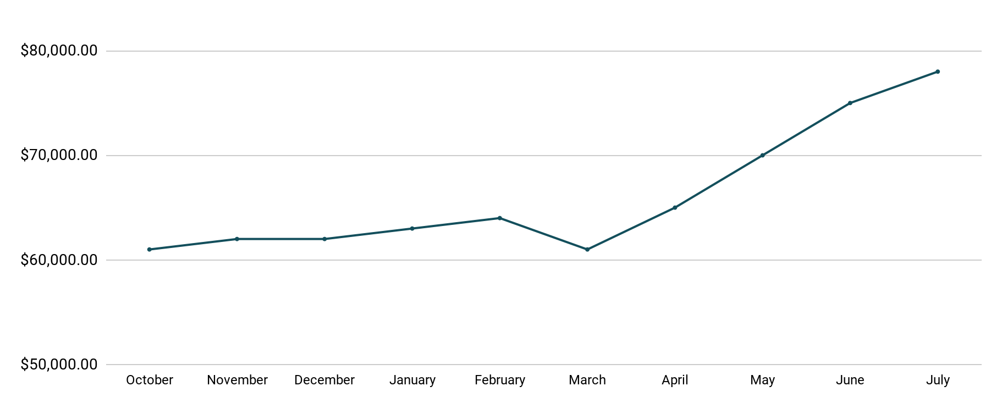
Revenue
Tablet Launch April 23
This is a chart of Sauce & Spoon revenue, showing that after tablet implementation, revenue increased.
July revenue was up to 20% over April’s monthly revenue.
Notes:
This is a chart of Sauce & Spoon revenue, showing that after tablet implementation, revenue increased. December revenue was up to 20% over September’s monthly revenue.
Sales data:
October
$61,000.00
November
$62,000.00
December
$62,000.00
January
$63,000.00
February
$64,000.00
March
$61,000.00
April
$65,000.00
May
$70,000.00
June
$75,000.00
July
$78,000.00

Slide 7
What Worked: Key Accomplishments
Decreased table turn time
Implementation of the tablets increased the average daily guest count by 10%.
Tablets also decreased wait time by 30 minutes.
Decreased food waste
Tablets identified who was receiving an incorrect order.
Kitchen staff has taken the initiative to correct orders and decrease food waste by 50%.
Increased customer satisfaction
After the pilot, customer satisfaction was at 72%.
Once we implemented improvements based on feedback, customer satisfaction increased to 86%.
Increased sales
Our monthly revenue has increased steadily since the tablet rollout, upwards of 20% since September/pre-rollout.
Tablets also helped boost revenue during the holiday season.

Slide 8
Next Steps: Looking Forward
Plan for the rollout to the rest of Sauce & Spoon’s locations
Continue to monitor and update installed tablets
Work to get Riverfront location to increase guest count by over 20%
Continue to improve order accuracy
Continue to generate surveys and solicit guest feedback.

Slide 9
Next Steps: Initiative & Action
Initiative | Action | Date
Implement tablets in more locations | Create new project plan for new location installation | Q2
Continue to track customer experience and satisfaction | Continue surveying/ gathering data through various means | Ongoing
Expand tablet features | Investigate new features like social media integration, reservations, videos, etc. | Q4

Slide 10
Lessons Learned
Our guests seemed to have some trouble with the navigation, so we switched to a layout that they find much simpler
After struggling to reduce table turn time, we worked with the general managers on training and getting waitstaff to be more aware of guest pacing. This allowed us to eventually reduce turn time by the desired 30 minutes.
Our cash payment system is still leaving customers frustrated, and we implemented more registers and retrained staff to address the issue.

Slide 11
Appendix
Project Proposal
Project Charter
Stakeholder Analysis
Project Plan
Survey Results Presentation
Notes:
Insert link to your shared drive or a shared folder with all of the relevant project artifacts

